Slide 1



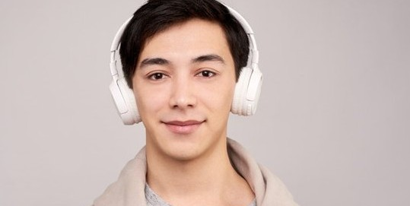

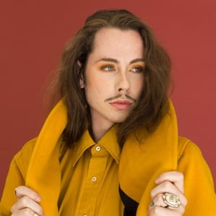
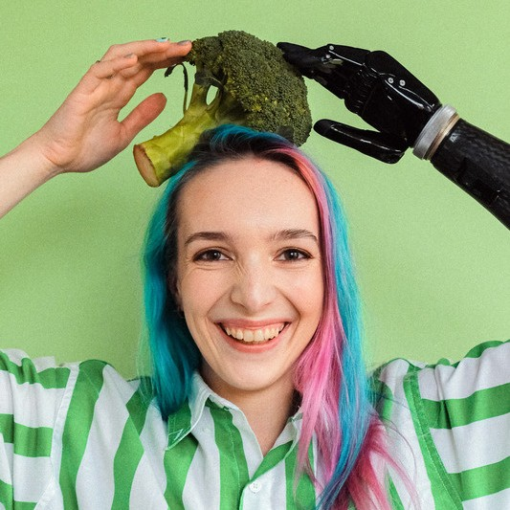


VIDEO
NG
STREAMI
WITH PYTHON

Slide 2



GROUP MEMBERS
M A Y A N K S H A R M A
N I S H A N T S H A R M A R I S H I R A J S I N G H
S A I R A M R E D D Y

Slide 3


Live Video Streaming using Socket Programming with Python
Live Streaming
Socket Programming
Why Python?
Streaming is the continuous transmission of audio or video files from a server to a client.
It shows how to use socket APIs to connect links between remote and local processes
Python provides 2levels access to network, and have already-made libraries
CN PROJECT

Slide 4
Reaching Highly Targeted Niches.
No Need to
Download the content
USE OF
VIDEO STREAMING
Real Time Engage ment

Slide 5
WHAT IS
SOCKET PROGRAMMING
Sockets and the socket API are used to send messages across a network. They provide a form of IPC.
The most common type of socket applications are client-server application where one side acts as the server and waits for connections from clients, this is the type of live video streaming application we are going to build.

Slide 6
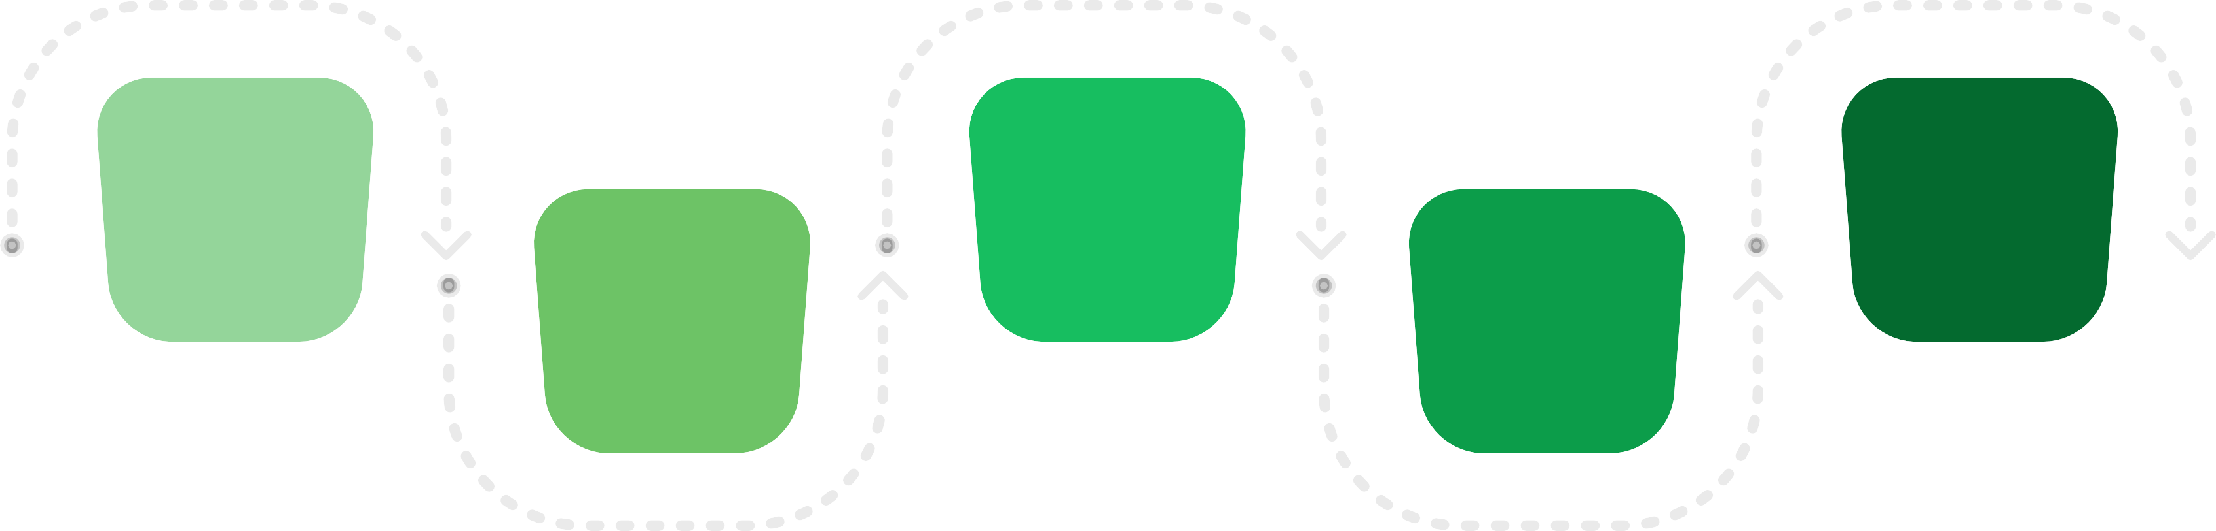
STEPS FOR SOURCE CODE
Step 2: Create Client Side Socket |  | Step 4: Stream video code from Server Side
1 | 3 | 5
2
4
Step1:
Install and import the open libraries.
Step 3: Create Server Side Socket
Step 5: Stream video code from Client Side

Slide 7
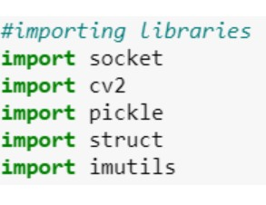
INSTALL AND IMPORT THE FOLLOWING LIBRARIES IN
BOTH THE FILES
Step1
socket: Get socket module from python
cv2: To import Computer Vision module from python
pickle: for serializing and de-
serializing python object structures. struct: to convert native Python data types into a string of bytes
imutils: Image processing operations

Slide 8
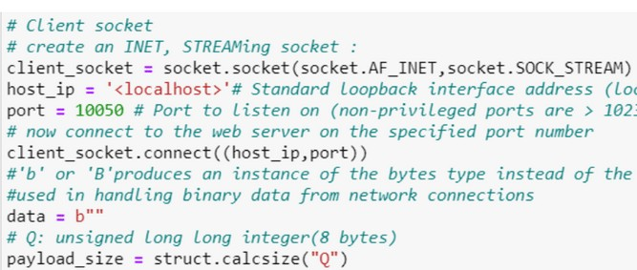
Client
C O D E

Slide 9
C O D E - E X P L A I N A T I O N
Client
client_socket = socket.socket(socket.AF_INET,socket.SOCK_STREAM) )-> we create a object of socket “client_socket”.
AF_INET means it is a Ipv4 address. SOCK_STREAM means that it is a TCP socket.
host_ip = ‘<local address>’-> specifies host ip address.
port = 10050-> server port number.
client_socket.connect((host_ip,port))-> for connecting to the remote socket. data = b""-> instance of variable data of byte string type.
payload_size = struct.calcsize("Q")->payload_size is defined by size of Q. Q is
unsigned long long integer.

Slide 10
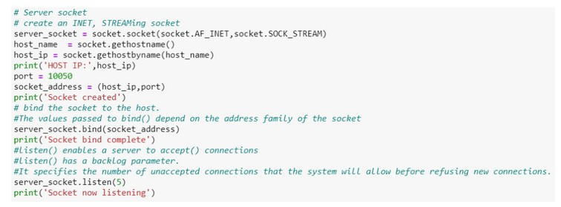
Source
C O D E

Slide 11
Source
C O D E - E X P L A I N A T I O N
server_socket = socket.socket(socket.AF_INET, socket.SOCK_STREAM)
-> with this line we create a object of socket “server_socket”. AF_INET means it is a Ipv4 address
SOCK_STREAM means that it is a TCP socket.
host_name = socket.gethostname()
host_ip = socket.gethostbyname(host_name)
these two lines is use for getting hostname and IP address of a local machine. port = 10050 -> for specifying port no.
socket_address = (host_ip,port)
server_socket.bind(socket_address) Assigns a socket to an address.

Slide 12
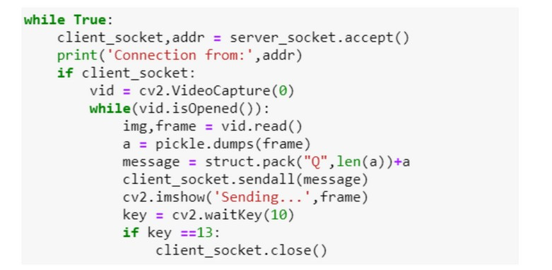
Stream Video
C O D E
S E R V E R S I D E

Slide 13
Stream Video
C O D E E X P L A N A T I O N S E R V E R S I D E
Server Side (i) Listening for any client request, client request +address.
(ii) If Client request –
Start Video Capture
While Loop (Checking if vdo looking or not)
Divide vdo in img and frame (important is frame).
Dump the frame (Using pickle).
Creating its message.
Send it to client socket .
cv.imshow – it will show which frame is transmitted.
Waitkey (press any key, waits 10 sec).
If key pressed = 13, close client.

Slide 14
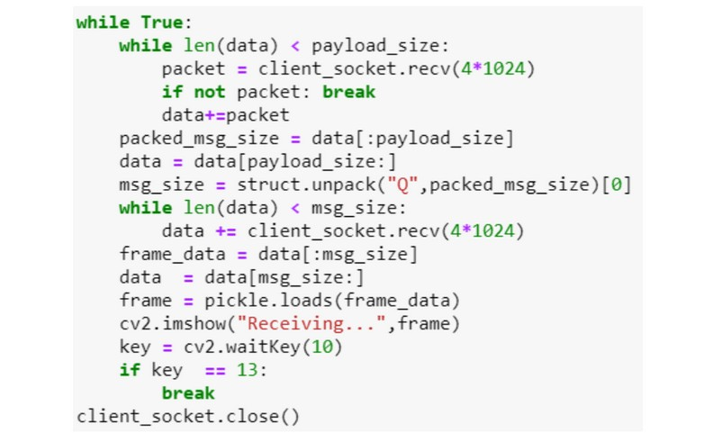
Stream Video
C O D E
C L I E N T S I D E

Slide 15
Stream Video
C O D E E X P L A N A T I O N C L I E N T S I D E
Client Side
Check if data < overall data size (takes data and append data)
Client_socket.rec(4*1024), here (4*1024) is data received in bytes.
Take all data.
Unnpack data.
Check len and receive packets.
Load frame.
Show loaded frame.

Slide 16
Expected Result
Conclusion :
Hence, in this way we can create a live video streaming application without audio which can be used for
purposes like surveillance, or may be to group study without disturbance etc.

Slide 17

ELEMENT IN SOURCE CODE
SOCKET
A socket is one endpoint of a two-way communication link between two programs running on the network. A socket is bound to a port number so that the TCP layer can identify the application that data is destined to be sent to.
SERVER
In the server side we use accept() as it blocks and waits. When a client connects, it returns a new socket object representing the connection and a tuple. The tuple will contain (host, port) for IPv4 connections or (host, port, flowinfo, scopeid) for IPv6.
CLIENT
The client creates a socket object, connects to the server and calls s.recv() to read the server’s reply . In the client side we receive data frames for the video streaming but in form of data packets
TCP
Transmission Control Protocol (TCP/IP) is a connection-oriented protocol. It is an intermediate layer of the application layer and internet protocol layer in the OSI model.

Slide 18
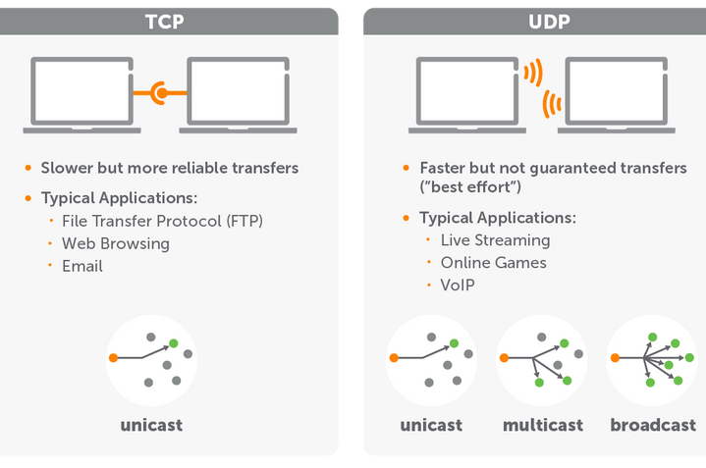
Streaming use the (UDP) or (TCP)?
UDP is recommended over TCP, but for our objective, TCP is suitable.
Is reliable: packets dropped in the network are detected and retransmit ed by the sender.
Has in-order data delivery.

Slide 19
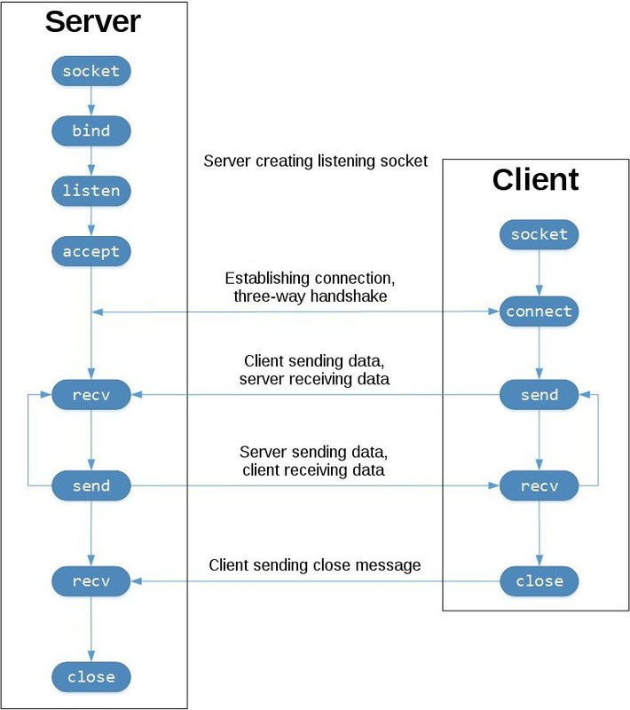
DATA FLOW FOR TCP:
The left represents the serverand right is the client.
Socket () function creates a socket on client as well as server side
Socket () function creates a socket on client as well as server side
Listen () function is used only in TCP/IP protocol to connection establishment on server side
Accept () function is called by the TCP/IP server.
Connect () function is used on client side.
Read () function is used to both side. Close () function is used to terminate the connection on both side.

Slide 20


Additional Feature:
01
Streaming video + Audio
Till now, we are able to create a live video streaming application without audio which can be used for purposes group study without disturbance etc.
We are trying to add audio also.
We are using TCP version socket here.
02
Monetization:
We are trying to add some real life application like collecting funds during live streaming.

Slide 21
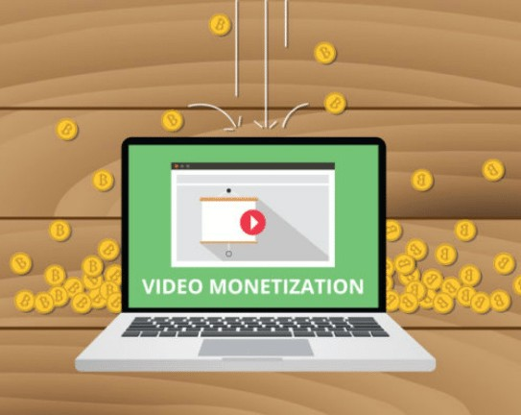

Monetization Of The Video Content
In this process, we can generate income through the videos, that we share online on any platform.
This is usually achieved through advertising, subscriptions, or direct transactions.
This is usually achieved through advertising, subscriptions, or direct transaction
One of the ways to monetize the video content is using the pay-per-view model by implementing video pay-walls. Generally, the incentive for the audience to pay for the live streaming content is more than the non-live content. For example, people are willing to pay, to access a live stream of sports events, remote attendance at a conference, and for events like music concerts, etc.
3 Profitable Monetization Models To Sell Videos Online
1 2 3
AVOD:
Advertising Video On Demand
SVOD:
Subscription Video On Demand
TVOD:
Transactional Video On Demand

Slide 22
GITHUB LINK
http s://mayank13-01.github.io/livevideostreaming/

